Slide 1
EEOB 590A: Data Management and Reproducible Research
8 September 2021

Slide 2
Today’s Class
Why manage data?
File organization
Reproducible research
Data management plans
GitHub – brief intro

Slide 3
1. Why manage data?

Slide 4
Why Manage Data: Researcher Perspective
Make backups to avoid data loss
Quality control your data more efficiently
Keep yourself organized – be able to find your files (data inputs, analytic scripts, outputs, etc)
Enable reproducibility – be able to match up your results/graphs with exact inputs that produced them
Version control– identify easily versions that can be periodically purged
Document your data for your own recollection, accountability to the scientific community, and re-use (by yourself or others)
Format your data for re-use (by yourself or others)
Prepare it to share it – gain credibility and recognition!
Notes:
Both for yourself & others

Slide 5
Why Data Management: Foundation for Advancement of Science
Data is a valuable asset – it is expensive and time consuming to collect
Data should be managed to:
maximize the effective use and value of data and information assets
continually improve the quality
ensure appropriate use of data and information
facilitate data sharing
ensure sustainability and accessibility in long term for re-use in science

Slide 6
Data management pipeline
Plan
Data Management
Collect
(raw data)
Quality Control
Metadata
Preserve
(tidy data)
Analyze & Graph
Published
Manuscript
Discover
Integrate
Adapted from DataOne Best Practices Primer

Slide 7
Data management goals
Data that are
Well-organized
Documented
Preserved
Accessible
Verified as to accuracy and validity
Result in
High quality data
Easy to share and re-use in science
Citation and credibility to the researcher
Cost-savings to science
Notes:
For each stage of the data lifecycle…there are best practices…..and….tools to help!
The following data management lessons will illustrate in detail each stage of the data lifecycle
Your well-managed and accessible data can contribute to science in ways you may not even imagine today!

Slide 8
2. File organization
Start off with a template folder for each R project
Bare minimum
Analysis
Data – raw & tidy
DataWrangling
Documents
Graphics
ReadMe

Slide 9
2. File organization
Analysis – scripts for analysis – no data files
Data
Raw (read-only, storage, not to be touched, pristine backup)
Tidy (intermediate and final R datasets)
DataWrangling
DataAcquisition.R – script for compiling all data files into a single dataset
DataWrangling.R – script for wrangling data into a tidy format
Documents
“Study overview” document(s)
“code book” or “data dictionary” describes the purpose and type of data for each variable in the database
“study design” or “protocol” describes exactly how the study was conducted
Generated documents from analyses - Rmarkdown, word docs, ppt.
Proposal that project was conducted under, IACUC docs etc.
Function Library (enables you to do the common things once.)
Graphics - both scripts and images
ReadMe
Write down the driving questions and purposes of the project & notes
References

Slide 10
2. File organization
Could get more complicated
Separate data from analysis for a particular manuscript
Use Box or GitHub?

Slide 11
3. What is “Reproducible research”?
Research is reproducible when:
Data and code are organized such that others can re-create your results.
Keys to reproducible research:
Raw data is saved.
Everything is done via code, not hand-editing, copy/paste, or point/click.
Code is well-documented and openly available so others can follow what you did
Research is reproducible when others can reproduce the results of a scientific study given only the original data, code, and documentation (Essawy et al. 2020). From Alston & Rick 2020

Slide 12
Reproducible Research
Plan
Collect
(raw data)
Quality Control
Metadata
Preserve
(tidy data)
Analyze & Graph
Published
Manuscript
Discover
Reproducible research == making this whole process open and repeatable
Integrate
Adapted from DataOne BP Primer
Notes:
Integrate: Data from multiple sources are combined into a form that can be readily analyzed. For example, you could combine citizen science project data with other sources of data to enable new analyses and investigations. Successful data integration depends on documentation of the integration process, clearly citing and making accessable the data you are using, and employing good data management practices throughout the Data Life Cycle.

Slide 13
What practical things can you do to make your research reproducible?

Slide 14
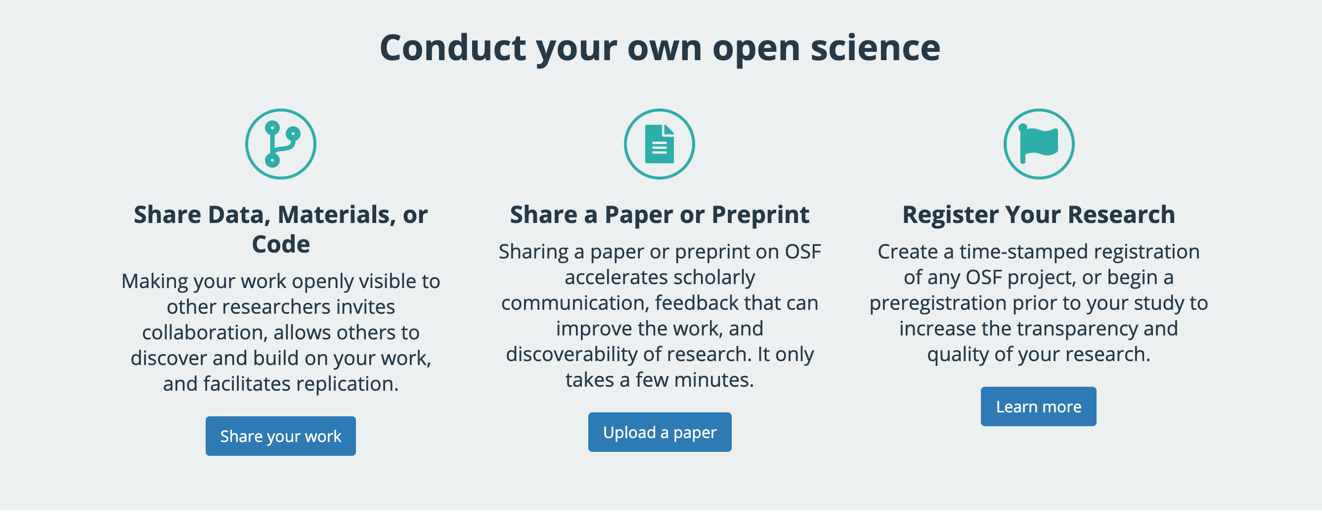
Open Science
Goal: To make the primary outputs of publicly funded research results – publications and the research data – publicly accessible in digital format with no or minimal restriction. To extend the principles of openness to the whole research cycle, fostering sharing and collaboration as early as possible thus entailing a systemic change to the way science and research is done. https://www.fosteropenscience.eu/content/what-open-science-introduction
Go to https://osf.io and search for a topic of your interest

Slide 15
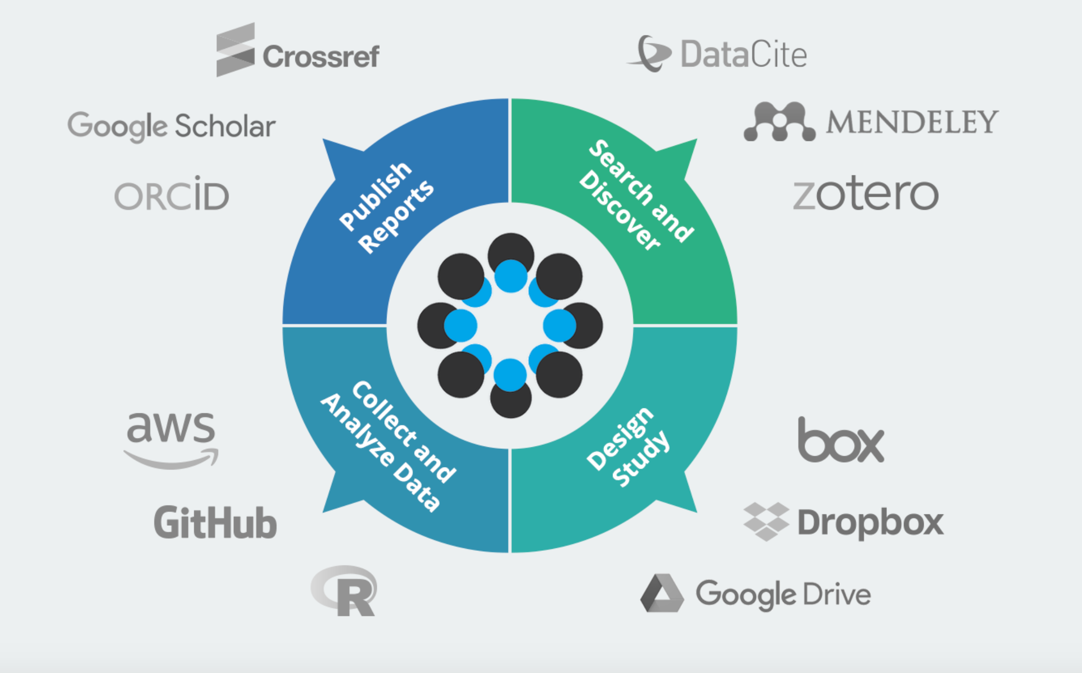
Open Science

Slide 16
4. Data management plan

Slide 17
Data management pipeline
Plan
Data management plan
Preserve & share
Collect
Quality Control
Metadata
Analyze & Graph
Published
Manuscript
Discover
Integrate

Slide 18
What is a Data Management Plan?
Formal document
Outlines what you will do with your data during and after you complete your research
Ensures your data is safe for the present and the future
Required by most funding agencies now
Notes:
A DMP is a formal document that outlines what you will do with your data both during and after your research project.
Data management plans are meant to ensure that your data will be preserved and useful both now and in the future, by both you and other researchers.

Slide 19
Data Management Plan – Swiss National Science Foundation
If your funding agency doesn’t require a particular format, this one seems logical.
Notes:
https://www.uzh.ch/blog/hbz/files/2018/11/Kapitel-DMP.jpg

Slide 20
Components of a General DMP for NSF
Data and materials produced
Standards, Formats and Metadata
Roles and responsibilities
Dissemination methods
Policies for data sharing and public access
Archiving, storage, and preservation
Other:
Clarify ethical/privacy/intellectual property issues, if necessary; Budget for costs related to data management
Notes:
For a general DMP, there are five main categories of information that should be included. Some funders or institutions may require specific elements in a data management plan; you should check with the agency or group for which you are preparing your DMP before beginning.
The slides that follow will go into more detail for each of the general categories on this slide. They are 1) Information about the data and its format, 2) information about the metadata content and format that will be used, 3) policies for access, sharing, and reuse of data, 4) long-term storage and data management, and 5) budget considerations for data management.

Slide 21
Tools for Creating Data Management Plans
DataOne – Dmptool.org
Go online now, and create a profile
DMPonline - dmponline.dcc.ac.uk
ISU libraries has a helpful website
Notes:
There are several tools available for creating data management plans. Two of the most commonly used are the DMPTool and DMP Online.
Both operate as “wizards” and provide prompts for the user to fill out in order to create their data management plan. You can save your plan, print it, or export it to your computer.

Slide 22
Find a data management plan online
https://dmptool.org/public_dmps
Search for your likely funding agency
One to check out (must be logged in): https://dmptool.org/plans/20143.pdf

Slide 23
DMP1: Data and materials produced
What type of data are you generating?
Electronic sensor output?
Field measurements by hand
Genetic data
How much data/how frequently is it produced?
What should you use to collect data?
Field notebook or datasheet or electronic data entry?
What is process of quality control?
How will you store data?

Slide 24
DMP1: Data and materials produced
How are you going to assure the data is of high quality?
Save scans of data
Proof data – several methods
If multiple data entry days, create a new datafile each time you enter data, then use script to compile data files
Save raw data files, and never touch them again.
Use script for “data wrangling” or “data munging to get raw data → tidy data

Slide 25
DMP1: Data and materials produced
Where/how do you store data?
Short term storage
Duplicate versions of hard copies of data
Back up electronic copies of data both on site and offsite (e.g. ISU network, CyBox, Dropbox, GitHub)
Long term storage (for raw & tidy data & scripts)
CyBox or GitHub

Slide 26
DMP2: Standards, Formats, and Metadata
What data or file format will you use?
Excel vs csv vs txt vs other formats
What metadata standards will you follow?
Can be quite informal or very formal

Slide 27
DMP2: Standards, Formats, and Metadata
Metadata is: Data ‘reporting’
WHO created the data?
WHAT is the content of the data?
WHEN were the data created?
WHERE is it geographically?
HOW were the data developed?
WHY were the data developed?
Notes:
Metadata is data about data. It describes the content, quality, condition, and other characteristics of a dataset.
Metadata records answer questions such as:
Why was the data set created?
What processes were used to create the data set?
What projection is the data in?
When was the data last updated?
Who created the data?
What scale was used?
What fields are in the table?
What do the values in those fields mean?
Who do I contact about getting more information about the data?
How do I obtain a copy of the data?
Do the data cost anything?
Are there any limitations to the data?
Metadata is a valuable tool. Metadata records preserve the usefulness of data over time by detailing methods for data collection and data set creation. Metadata greatly minimizes duplication of effort in the collection of expensive digital data and fosters the sharing of digital data resources.

Slide 28
DMP2: Standards, Formats, and Metadata
Organize your information
Did you write a project abstract to obtain funding for your proposal? Re-use it in your metadata!
Did you use a lab notebook or other notes during the data development process that define measurements and other parameters?
Do you have the contact information for colleagues you worked with?
What about citations for other data sources you used in your project?
Write your metadata using a metadata tool
Review for accuracy and completeness
Have someone else read your record
Revise the record, based on comments from your reviewer
Review once more before you publish
Notes:
Steps in creating quality metadata includes the following:
Organize your information. Before you begin gather your resources, particularly anything you may have already written about the dataset for another purpose. For example, a grant proposal that has a well-written abstract and purpose for the research is a great resource.
Write your metadata.
Review the record for accuracy and completeness.
Ask someone else read your record.
Revise your information based on comments from your reviewer, then review it once more before you publish it.

Slide 29
DMP2: Standards, Formats, and Metadata
Ecological Metadata Language (EML)
Focus on ecological data
http://knb.ecoinformatics.org/eml_metadata_guide.html
Darwin Core
Emphasis on museum specimens
http://rs.tdwg.org/dwc/index.htm
Geography Markup Language (GML)
Emphasis on geographic features (roads, highways, bridges)
http://www.opengeospatial.org/standards/gml
Notes:
There are many standards available to document data. Each has a different focus, yet ask for similar information about the data set.

Slide 30
DMP3: Roles and Responsibilities
Who will be involved in data management?
What happens if those people leave? What is the contingency plan?

Slide 31
DMP 4: Dissemination Methods
How will data and metadata be made available to others?
Data sharing (for published data & scripts)
Dryad – data underlying scientific & medical pubs
Figshare – any data, published or unpublished; get a DOI for each submission with all support files
Taxon or field-specific (e.g. ITIS, NCBI, GBIF, FlyBase)

Slide 32
DMP 4: Dissemination Methods -Dryad
How can I make my data submission as accessible and reusable as possible?
Provide ALL files needed to replicate your results, including code. One way to help ensure completeness is to explicitly link your data files (through their titles/descriptions) to the figures and analyses in your publication.
Submit your data files in non-proprietary formats from which data can be easily extracted (e.g., CSV rather than PDF).
Keep your file names short, informative, unique, and free of special characters.
Consider submitting your data files in multiple formats if you think that will enhance their ability to be reanalyzed. View additional guidance and a list preferred Dryad file formats.
Provide descriptive information within your data files (e.g., column headers in a spreadsheet).
Provide a ReadMe file that provides contextual information about the data file so that it can be interpreted correctly.
Provide titles, descriptions and keywords for your datafiles, to make the data more discoverable and to assist in understanding the relationship of the datafile to the publication.

Slide 33
DMP 5: Policies for Data Sharing and Public Access
What are the PI’s policies for data sharing, public access & re-use?
What are the provisions of confidentiality, security, intellectual property rights etc.?

Slide 34
DMP 6: Archiving, Storage and Preservation
What are the plans for archiving data, samples, software, and other research products?
Which data will be deposited for long-term access & where?
What facilities (physical & cyber) will be used to store & preserve data after the grant ends?

Slide 35
Data Management and Reproducible Research
Plan
Preserve
& Share
Collect
Quality Control
Metadata
Analyze & Graph
Published
Manuscript
Discover
Integrate

Slide 36


5. R, RStudio, Git, GitHub
Push
GitHub
commit
Pull

Slide 37
5. Git in R Studio
Notes:
You can create a .gitignore file in your repository's root directory to tell Git which files and directories to ignore when you make a commit. To share the ignore rules with other users who clone the repository, commit the .gitignore file in to your repository.
.Rproj - can track this via Git, but note that any changes one person makes will be made for all if pushed to GitHub. And each person must start with a cloned file and not create own .Rproj for it.

Slide 38
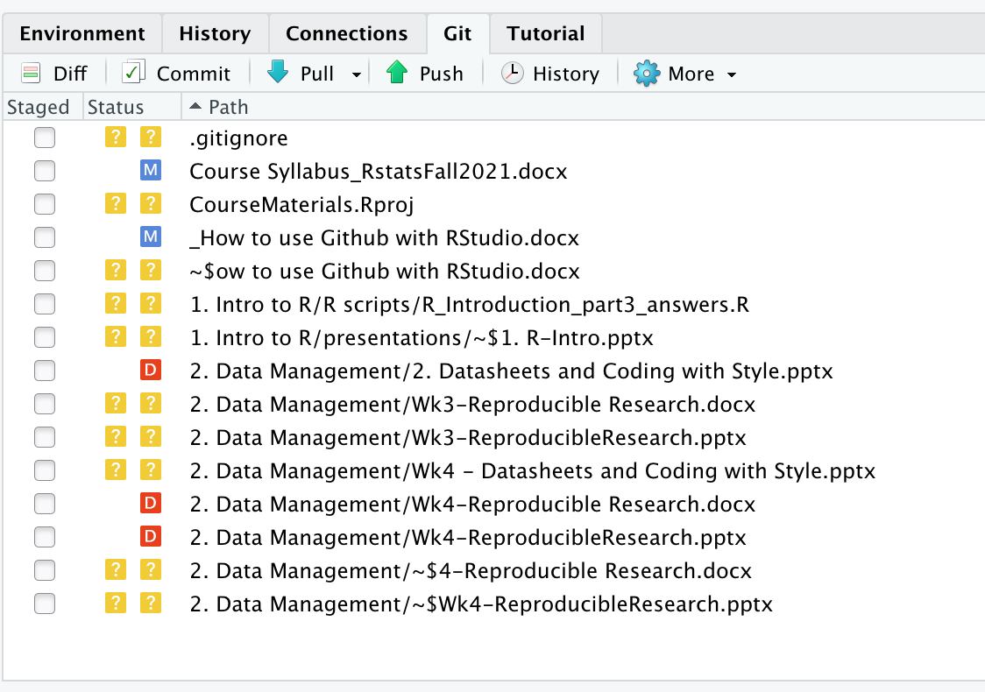

Slide 39
Using Rstudio, Git, and GitHub
Open R Studio Project
Pull Changes
Make edits to any files you want.
Stage files
Select files. To stage (select) a single file for inclusion, tick its check box. To stage all files, press Ctrl/Cmd + A, then click stage.
As you stage each file, you’ll notice that its status changes. The icon will change columns from right (unstaged status) to left (staged status), and you might see new icons (Added A or Renamed R)
Commit
Write commit message.
Commit your changes.
Push to GitHub Repository (don’t have to do this every time)
Close R Project when not in use.
Notes:
Added: after staging an untracked file, Git now knows that you want to add it to the repo.
Renamed: : If you rename a file, Git initially sees it as a deletion and addition. Once you stage both changes, Git will recognise that it’s a rename.
Sometimes you’ll see a status in both columns, e.g. . This means that you have both staged and unstaged changes in the same file. This happens when you’ve made some changes, staged them, and then made some more. Clicking the staged checkbox will stage your new changes, clicking it again will unstage both sets of changes.

Slide 40
For next week
Monday:
Wednesday: during class, will start own DMP

